Slide 1
Practice Lab:
This Practice Lab has no specific preceding Discussion Unit. A 101-level expertise is required on given terms; data center, keyspace, (and others, as listed on the Notes page below).
This Practice Lab is meant to address two issues:
-- After you create a new DSE cluster, a
number of the system keyspaces exist
with SimpleStrategy, and should be
altered to NetworkTopologyStrategy.
-- If you inherit a cluster with down nodes,
and seek to repair same, how to
determine if data is at risk.
DSE Core, alter, create, and examine keyspaces
Notes:
The goal of this Practice Lab is to work with keyspaces. Comments related to this Practice Lab:
There is no specific preceding Discussion Unit to this Practice Lab. Prerequisites include that you have a basic understanding of the following terms:
Data center, keyspace, table
Replication strategy, replication factor
Snitch
Generally understand the process of data replication within one DSE cluster
This Practice Lab has as a prerequisite that you are comfortable completing a DSE Tar ball install, and generally understand the cassandra.yaml and other similar DSE configuration files.
This Practice Lab also has the prerequisite that you can operate at the Linux command line; making directories, editing files, opening and using multiple terminal windows.
Generally, the goal of this exercise is to address the following concerns:
After the initial creation of a new DSE cluster, some of the system keyspaces exist with a SimpleStrategy replication strategy and they should be altered to call for NetworkTopologyStrategy.
Should you inherit, for example, a DSE cluster with (n) total nodes spread across (m) data centers, and (j) of the nodes are down; Are you okay to remove nodes ? Or, would removing nodes remove the only copy of some data ?

Slide 2
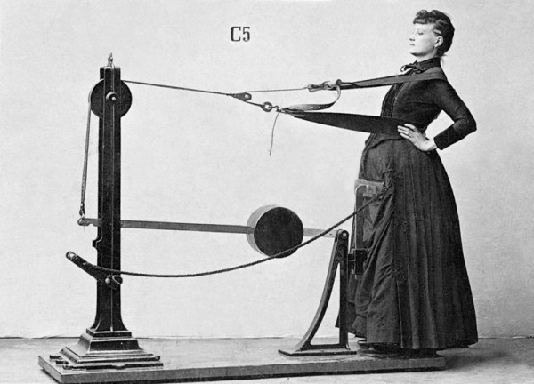
Challenge 1: Create a 2 DC, 1 Node per DC Cluster
Prerequisites:
Instructions are provided for Linux
We will operate below recommended settings; 1 OS node only, minimum 8 GB RAM, 12 GB RAM preferred
That you have downloaded a DSE Tar ball
That you are familiar with a DSE Tar ball install; cassandra.yaml, and similar
All prior DSE software is shut down, resources reclaimed
All work done as ‘root’
Notes:
To complete this Practice Lab, the following is assumed:
All prerequisites and conditions as listed above.

Slide 3

Challenge 1: Files, directories
Unpack the DSE Tar ball in /opt/node0
Copy these contents into
/opt/node1 # aka “node1”
/opt/node2 # aka “node2”
Under node1, node2, make a ./data folder
Under each ./data, make the folders
./cdc_raw
./commitlog
./data # results in ./data/data
./hints
./saved_caches
Notes:
Complete all steps as listed above.

Slide 4

Challenge 1: cassandra.yaml
In the cassandra.yaml in each of node1/node2, change:
cluster_name: 'my_cluster'
endpoint_snitch: org.apache.cassandra.locator.GossipingPropertyFileSnitch
- seeds: "127.0.0.1, 127.0.0.2"
(above, properly indented, same on both)
listen_address: 127.0.0.1 # node 1
listen_address: 127.0.0.2 # node 2
native_transport_address: 127.0.0.1 # node 1
native_transport_address: 127.0.0.2 # node 2
DseSimpleSnitch
PropertyFileSnitch
GossipingPropertyFileSnitch
Notes:
Complete all steps as listed above.
Do not cut and paste poorly, or you might inherit smart quotes and other issues from this (graphical/RTF) file.
From the cassandra.yaml, relative to the snitch setting,
# - it teaches Cassandra enough about your network topology to route
# requests efficiently
# - it allows Cassandra to spread replicas around your cluster to avoid
# correlated failures. It does this by grouping machines into
# "datacenters" and "racks." Cassandra will do its best not to have
# more than one replica on the same "rack" (which may not actually
# be a physical location)

Slide 5
Challenge 1: cassandra.yaml
In the cassandra.yaml in each of node1/node2, change:
commitlog_directory: /opt/dse/node1/data/commitlog # node 1
commitlog_directory: /opt/dse/node2/data/commitlog # node 2
(Each below different for node1, node2)
cdc_raw_directory: /opt/dse/node1/data/cdc_raw
hints_directory: /opt/dse/node1/data/hints
saved_caches_directory: /opt/dse/node1/data/saved_caches
data_file_directories:
- /opt/dse/node1/data/data
Notes:
Complete all steps as listed above.

Slide 6
Challenge 1: cassandra-env.sh
In the cassandra-env.sh in each of node1/node2, change:
The first two will be commented, uncomment and set to,
MAX_HEAP_SIZE="2048M" # Same both nodes
HEAP_NEWSIZE="200M" # Same both nodes
JMX_PORT="7199" # Node 1
JMX_PORT="7299" # Node 2
Notes:
Complete all steps as listed above.

Slide 7
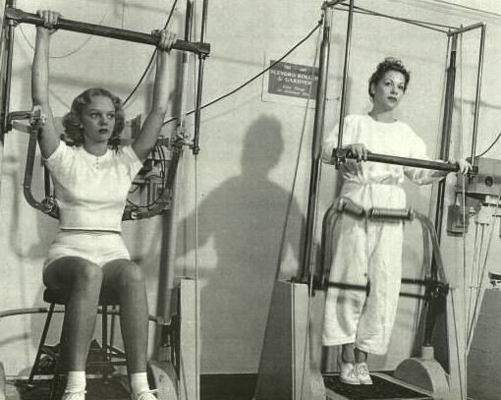
Challenge 1: logback.xml
In the logback.xml in each of node1/node2, [globally] change:
${cassandra.logdir}
to
/opt/dse/node1/ # node 1
/opt/dse/node2/ # node 2
Generally, this change is made 8 times.
Notes:
Complete all steps as listed above.

Slide 8
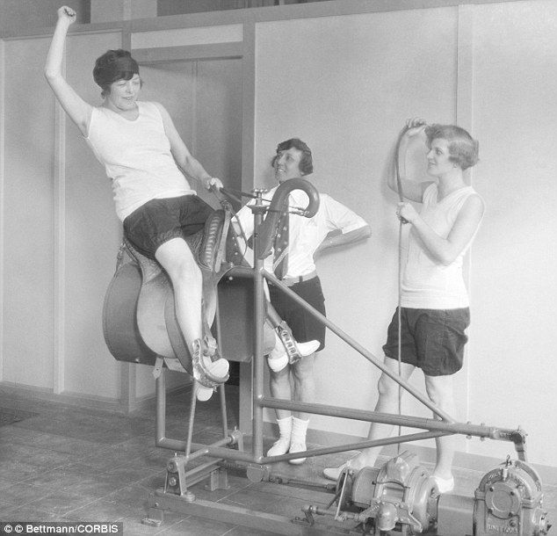
Challenge 1: cassandra-rackdc.properties
The node 1 (rackdc) properties file is fine. You only need to edit this file on node 2.
Make this change-
dc=dc2
Notes:
Complete all steps as listed above.
As stated above, this is a node 2 change only; node 1 is fine out of the box.

Slide 9
Challenge 1: Boot both DSE nodes
3 Linux terminal windows-
In window 1, cd /opt/dse/node1/bin
In window 2, cd /opt/dse/node2/bin
In both windows above,
./dse cassandra –f -R
In window 3,
cd /opt/dse/node1/bin
nodetool ring # repeat this command
Notes:
Complete all steps as listed above.
The last command, "nodetool ring", reports the cluster status. E.g., did we successfully boot our two node cluster ?

Slide 10
Challenge 1: Success
A successful exercise outputs-
# ./nodetool ring
Datacenter: dc1
==========
Address Rack Status State Load Owns Token
127.0.0.1 rack1 Up Normal 87.99 KiB ? 6676891273543202389
Datacenter: dc2
==========
Address Rack Status State Load Owns Token
127.0.0.2 rack1 Up Normal 40.39 KiB ? -3406290366391324992
Note: Non-system keyspaces don't have the same replication settings, effective ownership information is meaningless
Notes:
A successful Challenge 1 outputs two nodes up as the result of a "nodetool ring", and displays node 1 as being in DC-1 (dc1), and node 2 as being in DC-2 (dc2).
Be certain both nodes stay up; on certain errors, node 1 or 2 will come up and then shutdown (on failure).

Slide 11
Challenge 2: Changing system keyspaces
# cqlsh
Connected to my_cluster at 127.0.0.1:9042.
[cqlsh 5.0.1 | Cassandra 4.0.0.2284 | DSE 6.0.0 |
CQL spec 3.4.5 | DSE protocol v2]
Use HELP for help.
cqlsh> use system_schema;
cqlsh:system_schema> describe tables;
tables triggers views keyspaces dropped_columns
functions aggregates indexes types columns
cqlsh:system_schema> select * from keyspaces;
Notes:
Comments related to Challenge 2:
After you initially boot a new DSE cluster, (n) system keyspaces are created.
Some of these keyspaces are created with the following replication strategies, and are fine: LocalStrategy, EverywhereStrategy
Some of these keyspaces are created with SimpleStrategy/RF=1, and you should ALTER KEYSPACE on these keyspaces to increase their level of (high availability).
All of these commands are specific to release 6.0 of DSE. Prior to release 6.0 of DSE, different system keyspaces names or table names were in place.
Using CQLSH, call to use the system_schema keyspace. Example as shown-
View the available tables using, DESCRIBE TABLES;
And return the contents of the "keyspaces" table using, SELECT * FROM keyspaces;
Output on next page-
Refererence Urls:
https://docs.datastax.com/en/dse/6.0/cql/cql/cql_using/useQuerySystemTable.html

Slide 12
Challenge 2: Which keyspaces need change ?
cqlsh:system_schema> select * from keyspaces;
keyspace_name | ... | replication
--------------------+ ... +-------------------------------------------------------------------------------------
system_auth | ... | {'class': 'org.apache.cassandra.locator.SimpleStrategy', 'replication_factor': '1'}
system_schema | ... | {'class': 'org.apache.cassandra.locator.LocalStrategy'}
dse_system_local | ... | {'class': 'org.apache.cassandra.locator.LocalStrategy'}
dse_system | ... | {'class': 'org.apache.cassandra.locator.EverywhereStrategy'}
dse_leases | ... | {'class': 'org.apache.cassandra.locator.SimpleStrategy', 'replication_factor': '1'}
solr_admin | ... | {'class': 'org.apache.cassandra.locator.EverywhereStrategy'}
system_distributed | ... | {'class': 'org.apache.cassandra.locator.SimpleStrategy', 'replication_factor': '3'}
system | ... | {'class': 'org.apache.cassandra.locator.LocalStrategy'}
dse_perf | ... | {'class': 'org.apache.cassandra.locator.SimpleStrategy', 'replication_factor': '1'}
system_traces | ... | {'class': 'org.apache.cassandra.locator.SimpleStrategy', 'replication_factor': '2'}
dse_security | ... | {'class': 'org.apache.cassandra.locator.SimpleStrategy', 'replication_factor': '1'}
(11 rows)
cqlsh:system_schema>
Notes:
Comments related to Challenge 2:
In the output above, (n) system keyspaces were created upon initial creation of our DSE cluster.
Some of these keyspaces have a replication strategy of LocalStrategy or EverywhereStrategy, and should not be changed.
Some of these keyspaces have a replication strategy of SimpleStrategy, and should be changed. (SimpleStrategy and replication factor == 1 (RF=1), equals a single point of failure.) Since we have a two node, two data center DSE cluster (created in Challenge 1), we should alter these keyspaces to use a NetworkTopologyStrategy.

Slide 13
Challenge 2: ALTER KEYSPACE
# cqlsh
alter keyspace system_auth
with replication =
{
'class' : 'NetworkTopologyStrategy',
'dc1' : 1,
'dc2' : 1
}
and
durable_writes = 'true' ;
Warnings :
When increasing replication factor you need to run a a non-incremental repair on all nodes to distribute the data (nodetool repair -pr).
Notes:
Comments relative to Challenge 2:
Using CQLSH, execute an ALTER KESPACE statement similar to that as displayed above.
In this example, we call to change the "system_auth" keyspace from SimpleStrategy to NetworkTopologyStrategy.
The above changes the (metadata, schema) for this keyspace, as output above, we need to run "nodetool repair" in order to call to move data tokens to their new requisite nodes.
ALTER KEYSPACE is documented here,
https://docs.datastax.com/en/dse/6.0/cql/cql/cql_reference/cql_commands/cqlAlterKeyspace.html

Slide 14
Challenge 2: nodetool repair
# nodetool -h 127.0.0.1 repair -pr
[2018-06-23 ... ] Starting repair command #1 ... repairing keyspace dse_system with ...
[2018-06-23 ... ] Repair session ... finished
[2018-06-23 ... ] Repair completed successfully
[2018-06-23 ... ] Repair command #1 finished in 0 seconds
[2018-06-23 ... ] Replication factor is 1. No repair is needed for keyspace 'dse_leases'
[2018-06-23 ... ] Starting repair command #2 ... repairing keyspace solr_admin with ...
[2018-06-23 ... ] Repair session ... finished
[2018-06-23 ... ] Repair completed successfully
[2018-06-23 ... ] Repair command #2 finished in 0 seconds
[2018-06-23 ... ] Replication factor is 1. No repair is needed for keyspace 'dse_perf'
[2018-06-23 ... ] Starting repair command #3 ... repairing keyspace system_traces with ...
[2018-06-23 ... ] Repair session ... finished
[2018-06-23 ... ] Repair completed successfully
[2018-06-23 ... ] Repair command #3 finished in 0 seconds
[2018-06-23 ... ] Replication factor is 1. No repair is needed for keyspace 'dse_security'
[2018-06-23 ... ] Starting repair command #4 ... repairing keyspace system_auth with ...
[2018-06-23 ... ] Repair session ... finished
[2018-06-23 ... ] Repair completed successfully
[2018-06-23 ... ] Repair command #4 finished in 0 seconds
Notes:
Comments relative to Challenge 2:
Because we are running DSE nodes on specific IP addresses (127.0.0.1/2), we must repeat the "nodetool repair" on each address. We specify a specific IP address via the "-h (address)" parameter.
The "-pr" parameter to "nodetool" repair calls to repair the "primary partition range". Further details at the following Url,
https://docs.datastax.com/en/cassandra/3.0/cassandra/tools/toolsRepair.html
-pr, --partitioner-range
Repair only the primary partition ranges of the node. To avoid re-repairing each range RF times, DataStax recommends using this option during routine maintenance (nodetool repair -pr) or using the OpsCenter Repair Service .
Note: Not recommend with incremental repair because incremental repairs marks data as repaired during each step and does not re-repair the same data multiple times.
Above we call to ALTER KEYPACE only for the keyspace titled, "system_auth". A completed/successful Practice Lab changes one keyspace only; subsequent keyspaces would be redundant from a perspective of learning this procedure.

Slide 15
Challenge 2: Confirm change
cqlsh:system_schema> select * from keyspaces;
keyspace_name | ... | replication
---------------+-----+---------------------------------------------------------------------
system_auth | ... | {'class': 'org ... NetworkTopologyStrategy', 'dc1': '1', 'dc2': '1'}
...
Notes:
Confirming a successfully completed Challenge 2.

Slide 16


Challenge 3: Will [ you ] cause data loss ? [Discuss]
nodetool decommission
nodetool netstats
node down , N
RF > # of down nodes
node down, Y
Simple
Strategy
RF <= # of down nodes
RF spans DCs, At least 1 DC not affected
Network
Topology
Strategy
RF > # of down nodes AT LEAST 1 DC
RF spans all DCs and
RF <= # of down nodes IN EACH DC
Most likely ? Restore from backup
Notes:
Comments relative to Challenge 3:
Challenge 3 is a discussion only-
We don't have enough hardware currently to really test this (not enough nodes), so we'll discuss.
Imagine you have a 2 DC cluster, 4 nodes per DC (8 nodes total). And imagine 2 nodes are down in one DC. You can't get either of these 2 nodes to come back up; Can you just blow the down node(s) away ?
What scenarios place you at risk of losing data ? (Below, and on chart above.)
To be certain; you have to check each user created keyspace, and also table. (Are there empty tables you thought otherwise at risk.)
If the node is up, and you need it to go away, a "nodetool decommission" will stream said node's data to other nodes. "Causes a live node to decommission itself, streaming its data to the next node on the ring."
https://docs.datastax.com/en/dse/6.0/dse-admin/datastax_enterprise/tools/nodetool/toolsDecommission.html
https://docs.datastax.com/en/dse/6.0/dse-admin/datastax_enterprise/tools/nodetool/toolsNetstats.html
If the node is down and you can't bring it back up, you have to work harder.
In 3 of the 5 scenarios above, the replication setting will protect you.
In 2 of the 5 scenarios, you have more than 1 node down and you have a number of nodes down greater or equal to your replication factor. That's bad.
Another unit is this course covers backup and recovery. One scenario; You can restore a node away from the cluster, dump its data, then load that data back into the cluster at large.
But, it should never come to this. Your RF should be at least 3, and across DCs. How did you ever lose so many nodes concurrently (and for longer than 3 hours), that you had to restore to backup ?

Slide 17

Practice Lab:
Lessons Learned
Notes:
Discuss what worked well, poorly, from the Practice Lab.

Slide 18
Notes:
End of Practice Lab-

